Slide 1
Class 09- Tuple
Intro to tuple and its related operations

Slide 2
Introduction to Tuple
Python tuple are containers that are used to store tuple of heterogeneous values.
Python tuple are immutable. That means we cannot change the elements inside the tuple.
Tuple is a type of sequence like strings and lists but it differs from them in the way that tuple and strings are immutable but list are mutable.

Slide 3
Creating Tuple
Empty tuple :
l = tuple() or l =()
Single Element Tuple:
l = (value,) or l = value,
Nested tuple:
l = (1 , 2 , (38 , 49) , 6)
Creating tuple from existing sequences:
l = tuple(<sequence>) #show this example..!!

Slide 4
Accessing Tuple
Tuple are non-editable collection of elements just like string(collection of characters).
Therefore we imply similar loop structures for tuple.

Slide 5
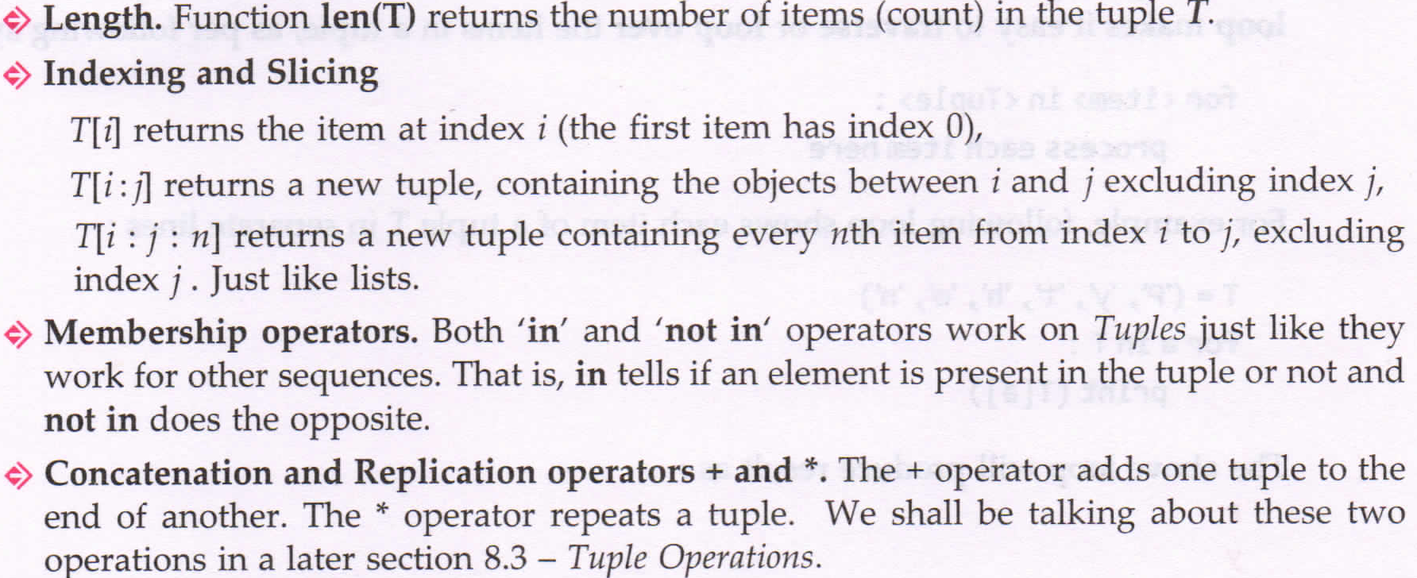
Similarity of tuple with strings

Slide 6
Accessing Individual Elements
Try out with vowels = (‘a’ , ’e’ , ’i’ , ’o’ , ’u’)
vowels[0], vowels[4], vowels[-1], vowels[-3]
ACCESSING values beyond length of tuple elements vowels[5]
Since tuple are immutable, it does not support value object assignment.

Slide 7
Traversing a tuple
for loop makes it easy to traverse or loop over items in a tuple.
Traversing tuple is similar to traversing strings. It also same to methods of accessing elements using indexing and variable equivalent.
l = (10,12,34,1,43,6)
Method1 :
for i in range(len(l)):
print(l[i]) #Indexing Method
Method2:
for var in l:
print(var) #variable equivalent

Slide 8
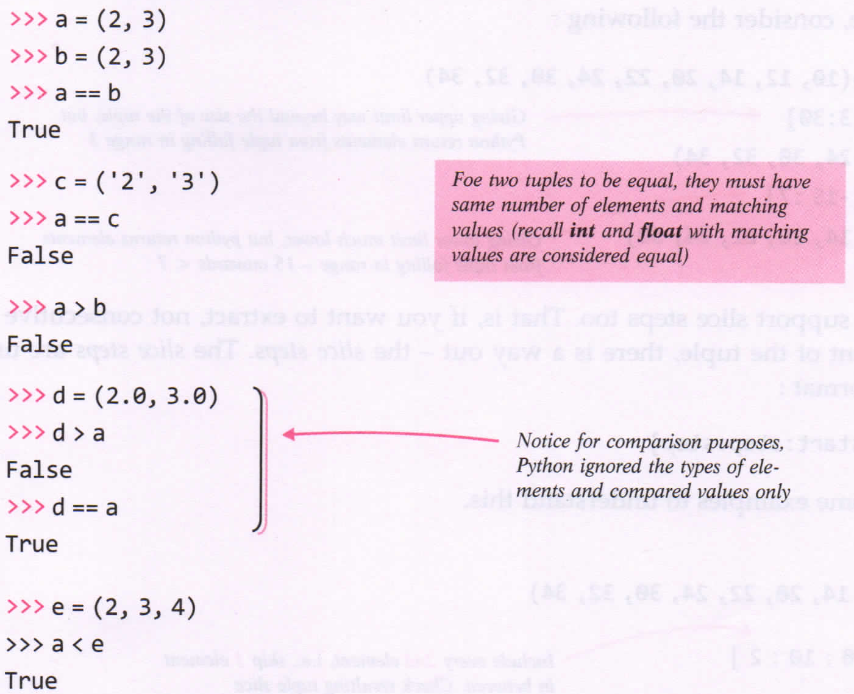
Tuple Comparison

Slide 10
Tuple Operations
Joining tuple
Repeating or Replicating tuple
Slicing tuple

Slide 11
Joining tuple(+ operator)
Similar to string concatenation, 2 tuple can also be concatenated into a new tuple having elements of the parent tuple.
To perform this, we use + operator.

Slide 13
Repeating or replicating tuple (* operator)
Like strings we can use * operator to replicate a tuple specified number of times
When used with tuple, the + operator requires both the operands as tuple-types and the * operator requires a list and an integer.

Slide 14
Slicing the tuple
tuple slices, lie string slices are the sub part of a tuple extracted out.
FORMAT: seq = T[start:stop]
Variable seq wil have elements of tuple L on indexes start, start+1, start+2, ..... , stop-2, stop-1. (Similar to string slicing).
tuple also supports slice steps:
FORMAT: seq = L[start:stop:step]

Slide 18
Functions in tuple
len()
max()
min()
index()
count()
tuple()

Slide 19
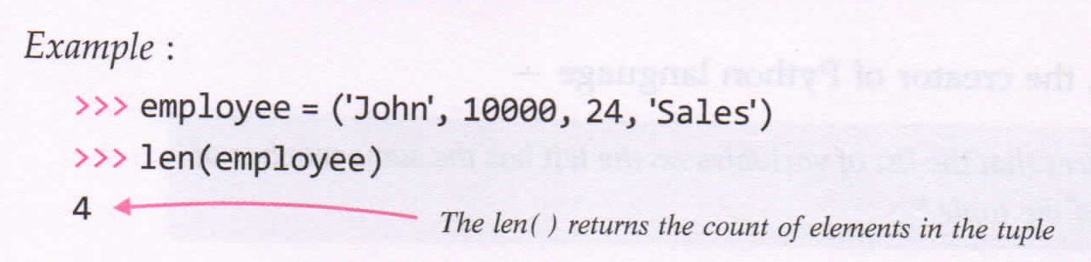
len()
Method returns length of the tuple, i.e., count of number of elements in the tuple.
Syntax : len(<tuple>)
Takes tuple name as argument and returns an integer

Slide 20
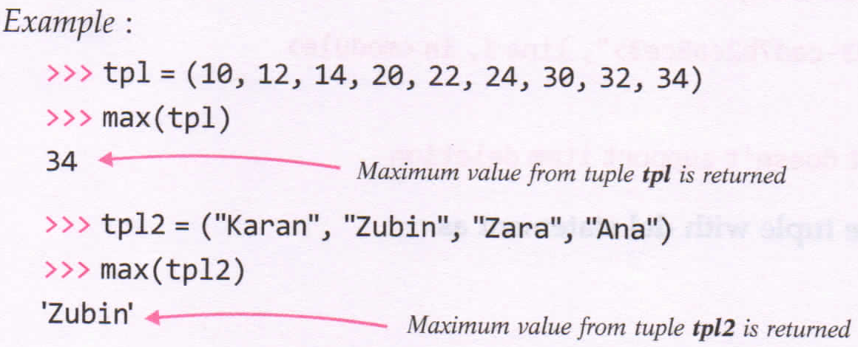
max()
This method returns the element from the tuple having maximum value.
Syntax: max(<tuple>)
takes tuple name as argument and returns an object(the element with maximum value).

Slide 21
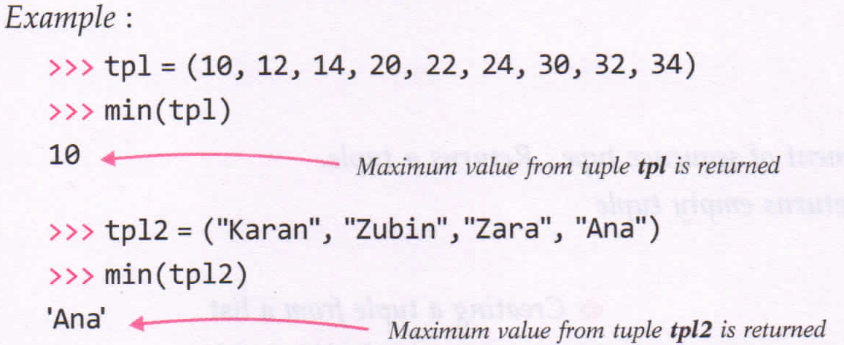
min()
This method returns the element from the tuple having minimum value.
Syntax: min(<tuple>)
Takes tuple name as argument and returns an object(the element with minimum value).

Slide 22
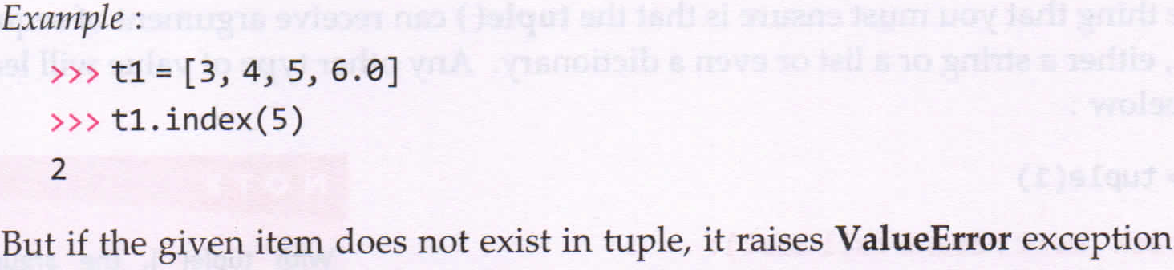
index() method
The function return the index of first matched item from the tuple.
FORMAT: tuple.index(<item>)

Slide 23
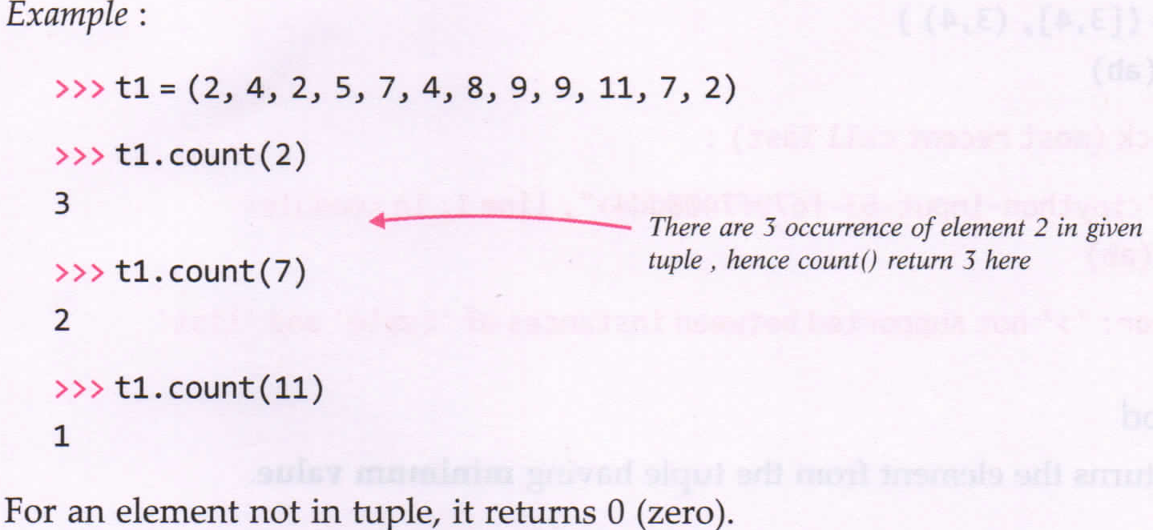
count() method
Function returns the count of the item that you passed a argument.
If the given item is not in the tuple it return zero.
FORMAT: tuple.count(<item>)

Slide 24
tuple() method
This method is actually a constructor method that can be used to create tuple from different types of values.
Syntax: tuple(<sequence>)
Takes an optional argument of sequence
Returns a tuple.
With no argument, it returns an empty tuple.

Slide 25
Programs
P1: Program to print elements of a tuple(‘Hello’, ’Is’, ‘Python’, ‘fun’, ‘?’) in separate lines along with the element’s both positive and negative indexes.

